Slide 1
Probabilistic IR

Slide 2
Why probabilities in IR?
User
Information Need
Query
Representation
Understanding
of user need is
uncertain
How to match?
Document
Representation
Uncertain guess of
whether document has relevant content
Documents
In traditional IR systems, matching between each document and
query is attempted in a semantically imprecise space of index terms.
Probabilities provide a principled foundation for uncertain reasoning.
Can we use probabilities to quantify our uncertainties?

Slide 3
vector space vs. probabilistic
Vector space model: rank documents according to similarity to query.
The notion of similarity does not translate directly into an assessment of “is the document a good document to give to the user or not?”
The most similar document can be highly relevant or completely non-relevant.
Probability theory is arguably a cleaner formalization of what we really want an IR system to do: give relevant documents to the user.

Slide 4
The document ranking problem
We have a collection of documents
User issues a query
A list of documents needs to be returned
Ranking method is the core of an IR system:
In what order do we present documents to the user?
We want the “best” document to be first, second best second, etc….
Idea: Rank by probability of relevance of the document w.r.t. information need
P(R=1|document_{i}, query)

Slide 5
Recall a few probability basics
For events A and B:
Bayes’ Rule
Odds:
Prior
Posterior

Slide 6
The Probability Ranking Principle
“If a reference retrieval system’s response to each request is a ranking of the documents in the collection in order of decreasing probability of relevance to the user who submitted the request, where the probabilities are estimated as accurately as possible on the basis of whatever data have been made available to the system for this purpose, the overall effectiveness of the system to its user will be the best that is obtainable on the basis of those data.”
[1960s/1970s] S. Robertson, W.S. Cooper, M.E. Maron; van Rijsbergen (1979:113); Manning & Schütze (1999:538)

Slide 7
Probability Ranking Principle
Let x represent a document in the collection.
Let R represent relevance of a document w.r.t. given (fixed)
query and let R=1 represent relevant and R=0 not relevant.
Need to find p(R=1|x) - probability that a document x is relevant.
p(R=1),p(R=0) - prior probability
of retrieving a relevant or non-relevant
document
p(x|R=1), p(x|R=0) - probability that if a relevant (not relevant) document is retrieved, it is x.

Slide 8
Probability Ranking Principle (PRP)
Simple case: no selection costs or other utility concerns that would differentially weight errors
PRP in action: Rank all documents by p(R=1|x)

Slide 9
Probability Ranking Principle
More complex case: retrieval costs.
Let d be a document
C – cost of not retrieving a relevant document
C’ – cost of retrieving a non-relevant document
Probability Ranking Principle: if
for all d’ not yet retrieved, then d is the next document to be retrieved
We won’t further consider cost/utility from now on

Slide 10
Probability Ranking Principle
How do we compute all those probabilities?
Do not know exact probabilities, have to use estimates
Binary Independence Model (BIM) – which we discuss next – is the simplest model
Questionable assumptions
“Relevance” of each document is independent of relevance of other documents.
Really, it’s bad to keep on returning duplicates
Boolean model of relevance
That one has a single step information need
Seeing a range of results might let user refine query

Slide 11
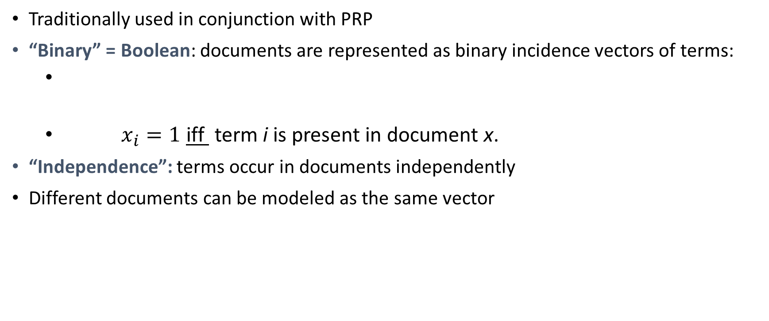
Binary Independence Model
Traditionally used in conjunction with PRP
“Binary” = Boolean: documents are represented as binary incidence vectors of terms:
$x_{i}=1$ iff term i is present in document x.
“Independence”: terms occur in documents independently
Different documents can be modeled as the same vector

Slide 12
Binary Independence Model
Queries: binary term incidence vectors
Given query q,
for each document d need to compute p(R|q,d).
replace with computing p(R|q,x) where x is binary term incidence vector representing d.
Interested only in ranking
Will use odds and Bayes’ Rule:

Slide 13
Binary Independence Model
Constant for a given query
Needs estimation
Using Independence Assumption:

Slide 14
Binary Independence Model
Since x_{i} is either 0 or 1:
Let
Assume, for all terms not occurring in the query (q_{i}=0)
A term not occurring in the query is equally likely to occur in relevant and non-relevant documents.

Slide 15
 | document | relevant (R=1) | not relevant (R=0)
term present | x_{i} = 1 | p_{i} | r_{i}
term absent | x_{i} = 0 | (1 – p_{i}) | (1 – r_{i})

Slide 16
Binary Independence Model
All matching terms
Non-matching query terms
All matching terms
All query terms
Notes:
Put all terms in query into right product and then divide through by them in left product.

Slide 17
Binary Independence Model
Constant for
each query
Only quantity to be estimated
for rankings
Retrieval Status Value:

Slide 18
Binary Independence Model
All boils down to computing RSV.
The c_{i} are log odds ratios
They function as the term weights in this model
So, how do we compute c_{i}’s from our data ?
Notes:
Used to say: Linear Discriminant Function, because it is a linear function in terms of log probabilities, but maybe that’s too far afield for here, and is better discussed later

Slide 19





bim retrieval status value (rsv)
$$r_{t}$$
$$r_{t}$$
$$r_{t}$$
$$r_{t}$$
$$r_{t}$$
$$r_{t}$$

Slide 20
avoiding zeros
If any of the counts is a zero, then the term weight is not well-defined.
Maximum likelihood estimates do not work for rare events.
To avoid zeros: add 0.5 to each count or use a different type of smoothing

Slide 21
Binary Independence Model
Estimating RSV coefficients in theory
For each term i look at this table of document counts:
Estimates:

Slide 22
Estimation – key challenge
If non-relevant documents are approximated by the whole collection, then r_{i} (prob. of occurrence in non-relevant documents for query) is n/N and

Slide 23
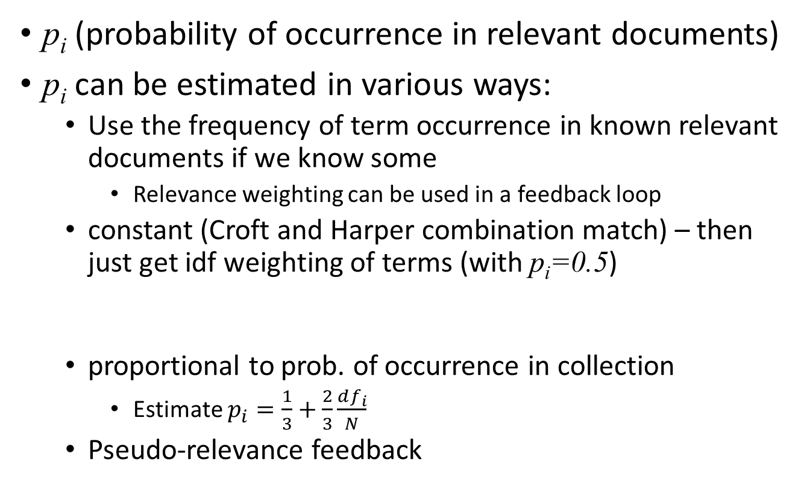
Estimation – key challenge
p_{i} (probability of occurrence in relevant documents)
p_{i} can be estimated in various ways:
Use the frequency of term occurrence in known relevant documents if we know some
Relevance weighting can be used in a feedback loop
constant (Croft and Harper combination match) – then just get idf weighting of terms (with p_{i}=0.5)
proportional to prob. of occurrence in collection
Estimate $p_{i}=\frac{1}{3}+\frac{2}{3}\frac{df_{i}}{N}$
Pseudo-relevance feedback

Slide 24
Probabilistic Relevance Feedback
Guess a preliminary probabilistic description of R=1 documents and use it to retrieve a first set of documents
Interact with the user to refine the description: learn some definite members with R=1 and R=0
Reestimate p_{i} and r_{i} on the basis of these
Or can combine new information with original guess (use Bayesian prior):
Repeat, thus generating a succession of approximations to relevant documents
κ is
prior
weight
Notes:
explicit Bayesian smoothing with a prior

Slide 25
Iteratively estimating p_{i} and r_{i} (= Pseudo-relevance feedback)
Assume that p_{i} is constant over all x_{i} in query and r_{i} as before
p_{i} = 0.5 (even odds) for any given doc
Determine guess of relevant document set:
V is fixed size set of highest ranked documents on this model
We need to improve our guesses for p_{i} and r_{i}, so
Use distribution of x_{i} in docs in V. Let V_{i} be set of documents containing x_{i}
p_{i} = |V_{i}| / |V|
Assume if not retrieved then not relevant
r_{i} = (n_{i} – |V_{i}|) / (N – |V|)
Go to 2. until converges then return ranking

Slide 26
Thanks

